Slide 1
Ezekiel 25-28
"Thus I will execute judgments…, and they will know that I am the LORD." (Ezekiel 25:11)

Slide 2
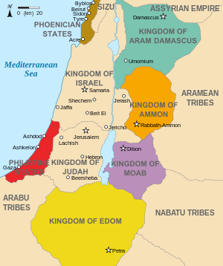
Ezekiel 25
While Jerusalem is under siege, Ezekiel turns his attention to foreign nations nearby. The next 8 chapters are devoted to seven nations beginning with Ammon…
God’s word to Ammon (25:1-7)
God’s word to Moab (25:8-11)
God’s word to Edom (25:12-14)
God’s word to Philistia (25:15-17)

Slide 3
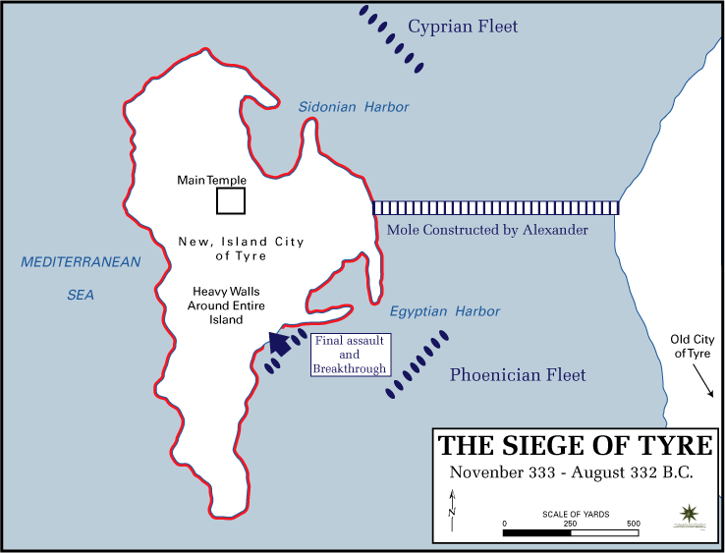
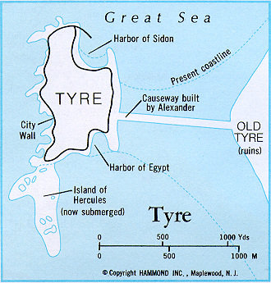
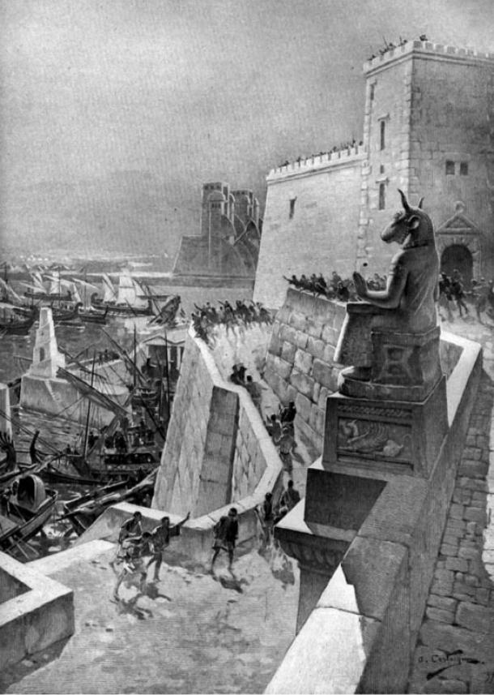
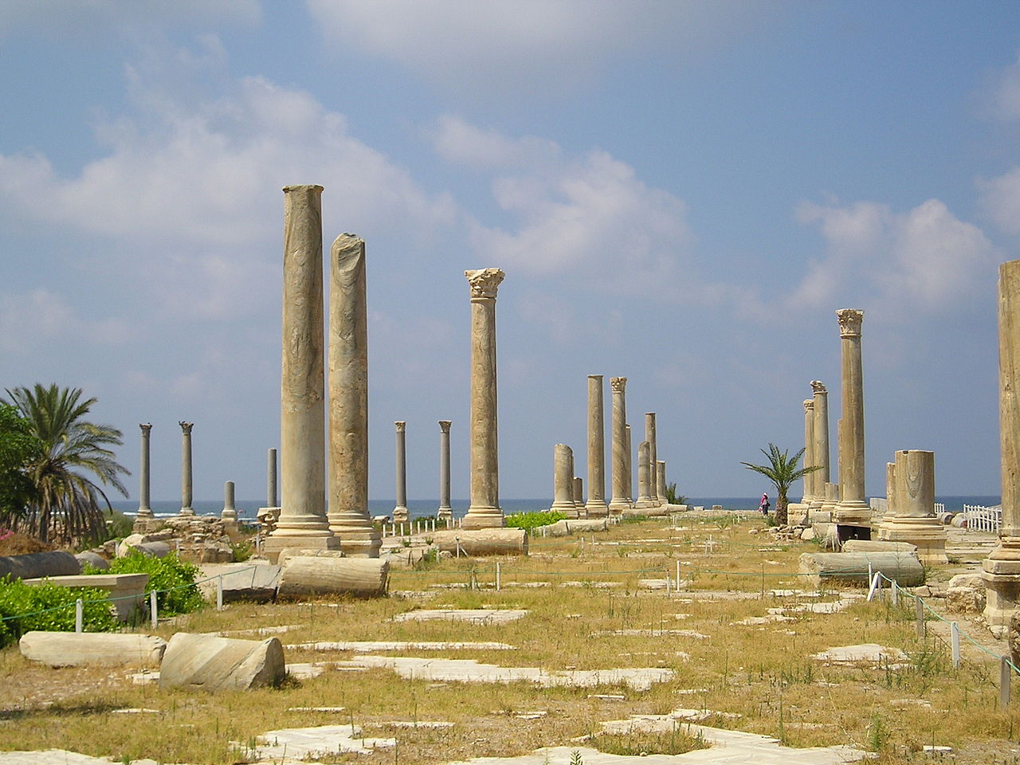
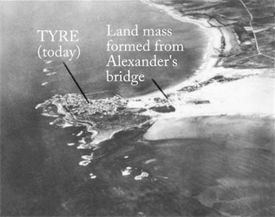

Slide 4
Ezekiel 26
Ezekiel 26-28 will focus on Phoenicia (Tyre/Sidon city states)…
The Destruction of Tyre (26:1-21)
The Reason for Destruction (26:1-3)
The Extent of Destruction (26:3-6)
The Agents of Destruction (26:7-14)
The Reaction to Destruction (26:15-18)
The Result of Destruction (26:19-21)

